Slide 1
Hello World! I’m alive!
#3

Slide 2
Hello!

Slide 3
Hello world!
/*
Author: Luis Oliveira
This is a simple example of a Java program
*/
public class Hello
{
public static void main( String[] args )
{
// This is the code that will run
System.out.print("Hello World!");
}
}

Slide 4
Hello world! - Decrypted
/*
This is a block comment. It starts with the “forward-slash asterisk”
Nothing you write here is seen by Java and it’s compiler.
It ends with the “forward-slash asterisk”, again
*/
public class Hello ← This is the class header Hello is it’s name
{
public static void main( String[] args ) ← This is where your program starts!
It’s the main function header
{
// This is an in-line comment. Next line is seen by Java!
System.out.print("Hello World!");
}
}

Slide 5
About variables

Slide 6
Primitive numeric variable types
Declaring a variable: type name = value;
byte - stores tiny integer numbers range: -128 → 127
short - stores small integer numbers range: -32,768 → 32,767
int - stores integer numbers range: -2,147,483,648 → 2,147,483,647
long - stores large integer numbers range: -9,223,372,036,854,775,808 → 9,223,372,036,854,775,807
float, double - store real numbers → double has more range and precision (more decimal places)
float range: 1.401e-45 to 3.402e38 (same negative)
double range: 4.941e-324 to 1.798e308 (same negative) → it’s complicated ☺

Slide 7
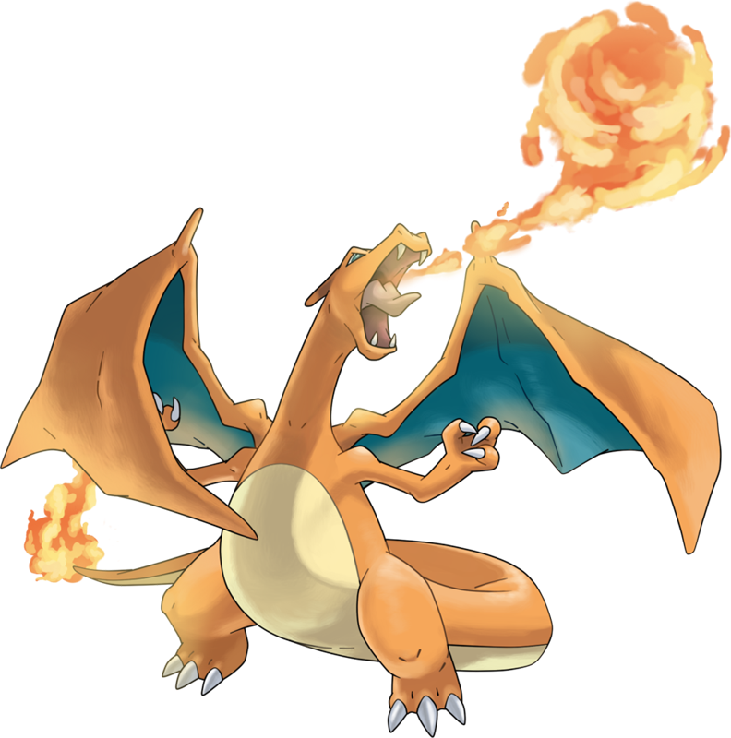
Primitive non-numerical variable types (and String)
char (like in charizard!)- stores text characters e.g.: A single letter, or a single punctuation mark
String – stores a text i.e, a bunch of chars variable size!
boolean – truthiness, i.e. true or false range: ermm… either true or false
others? – we can create types! But we’ll discuss that later
Check example Types.java

Slide 8
Literals
Note: Strings use double quotes, chars use single quotes!
When you type a number or string, that’s a literal.
Only primitive types and String have literals
String is special because it’s VERY common.
E.g.
type | literal
String | “Hello Luis!”
char | ‘X’
boolean | false
int | 42
double | 3.14159
String text = “Hello Luis!”;
char letter = ‘X’;
boolean validPoint = true;
int number = 42;
double pi = 3.14159;

Slide 9
Naming rules
Variables
Names must start with a letter or a _ (underscore)
Names can contain numbers
E.g: age, _age, part1, _variable
Names are all low-case, except to separate different words
E.g.: word, twoWords, threeWordVariable
Names are case sensitive: variable is not the same as vArIaBlE
Use good names!
Bad names: a, aa, aaa, abc, here, qwerty
I’ve seen this before: x, xx, xxx; ← Don’t!
Good names: age, height, position, distance, sumOfVariables

Slide 10
Naming rules (cont.)
Constants
Names must start with a letter or a _ (underscore)
Names can contain numbers
E.g: age, _age, part1, _variable
Names are all upper-case
E.g.: WORD, TWO_WORDS, MULTIPLE_WORD_CONSTANT
Use good names!
Use the keyword final
E.g. final int INCHES_IN_A_FOOT = 12;

Slide 11
Operations on variables
Assignments
= → The assignment operator (doesn’t compare) e.g.: destination = source
First calculate EVERYTHING to its right (variable or expression)
Finally store the result into the variable to it’s left
Examples:
age = 33; // age gets the number 33
age = age - 1; // age value is changed to 32 : the old
// value of age minus 1
halfAge = age / 2; // halfAge gets 16: the value of age divided by 2
Check example Operators.java

Slide 12
Java numeric operators (easy)
Operator | Name | Type | Example
- | Negation | Unary | result = -b;
* | Multiplication | Binary | result = a * b;
/ | Division | Binary | result = a / b;
% | Modulus | Binary | result = a % b;
+ | Addition | Binary | result = a + b;
- | Subtraction | Binary | result = a - b;
Check example Operators.java

Slide 13
Java relational operators (medium)
Operator | Name | Type | Example
== (don’t confuse with single = ) | Equals | Binary | a == b;
!= | Not equal | Binary | a != b;
> | Greater than | Binary | a > b;
>= | Greater than or equal | Binary | a >= b;
< | Less than | Binary | a < b;
<= | Less than or equal | Binary | a <= b;
Check example Operators.java

Slide 14
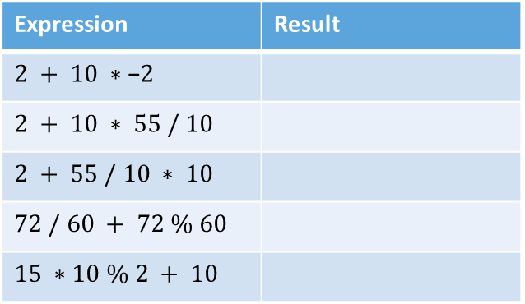

Java precedence of operators
What happens first?
People: Hate maths, love solving maths problems on Facebook ¯\_(ツ)_/¯
When in doubt ☺
Parentheses
$2 + 10 ∗ (55 / 10)$ is the same as $2 +(55 / 10)∗ 10$
First
Operator | Associativity
- (negation) | Right to left
* / % | Left to right
+ - | Left to right
Expression | Result
$$2 + 10 ∗\text{−}2$$
$$2 + 10 ∗ 55 / 10$$
$$2 + 55 / 10 ∗ 10$$
$$72 / 60 + 72 \% 60$$
$$15 ∗10 \% 2 + 10$$
-18
57
Last
52
13
10
Check example Precedence.java

Slide 15
Apples and Oranges
Integer types smaller than int, are converted to int :’)
aByte + 10 is an int
aByte + aByte is an int
aByte + aShort is an int
aShort + aShort is an int
Types larger than int keep their type
E.g., aByte + aLong is a long
Real numbers turn into the more precise type in expression
E.g., aDouble/aFloat is a double
Operations with Strings, become strings
“The number is: ” + anInt is a String
Check example Casts.java

Slide 16
Shrinking values (aka casts :)
Casts allow us to fit a LARGE type into a small type
But with great power…
anInt = 100;
aByte = (byte)anInt;
OK!
anInt = 200;
aByte = (byte)anInt;
DOESN’T FIT!

Slide 17
Numbers and binary

Slide 18
Positional number systems
The numbers we use are written positionally: the position of a digit within the number has a meaning.
2 0 0 0
2 x 10³
0 0 0
0 x 10²
2 0 1 9 =
=
1 0
1 x 10¹
+ 9
9 x 10⁰

Slide 19
Positional number systems
The numbers we use are written positionally: the position of a digit within the number has a meaning.
Most Significant
2 0 1 9
Least Significant
1000s
100s
10s
1s
10³
10²
10¹
10⁰
How many (digits) symbols do we have in our number system?
10: 0, 1, 2, 3, 4, 5 ,6 ,7, 8, 9

Slide 20
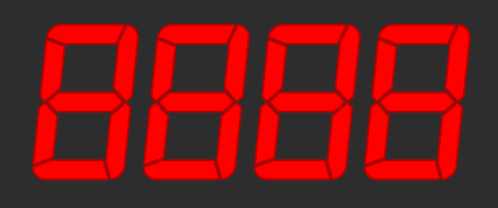
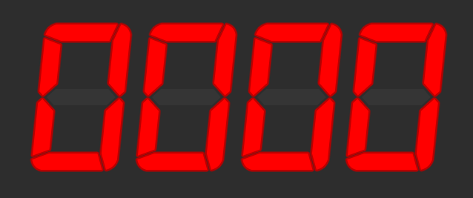
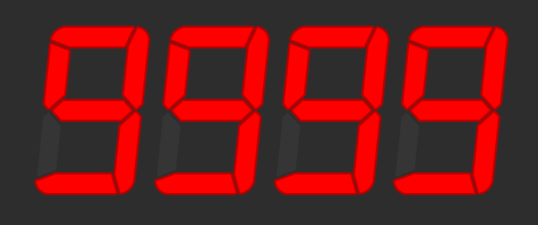
Range of numbers
Suppose we have a 4-digit numeric display.
What is the smallest number it can show?
What is the biggest number it can show?
How many different numbers can it show?
9999 - 0 + 1 = 10,000
What power of 10 is 10,000?
10⁴
Notes:
How do you calculate the number of elements in a range? max-min+1

Slide 21
Binary – Base 2

Slide 22
How many symbols in binary????
2

Slide 23
Binary (base-2)
We call a Binary digIT a bit – a single 1 or 0
When we say an n-bit number, we mean one with n binary digits
MSB LSB
1 × 128 +
0 × 64 +
0 × 32 +
1 × 16 +
0 × 8 +
1 × 4 +
1 × 2 +
0 × 1
= 150₁₀
1001 0110
=
2⁷ 2⁶ 2⁵ 2⁴ 2³ 2² 2¹ 2⁰
128s 64s 32s 16s 8s 4s 2s 1s
To convert binary to decimal: ignore 0s, add up place values wherever you see a 1.

Slide 24
Bits, bytes, nibbles
A bit is one binary digit, and its unit is lowercase b.
A byte is an 8-bit value, and its unit is UPPERCASE B.
A nibble (also nybble) is 4 bits
Corresponds nicely to a single hex digit.
When we say "32-bit CPU," we mean it was built to use 32-bit numbers.
This means it can, for example, add two 32-bit numbers at once.
– half of a byte

Slide 25
Round numbers
Decimal | Binary
10⁰ = 1 | 2⁰ = 1
10¹ = 10 | 2¹ = 2
10² = 100 | 2² = 4
10³ = 1000 | 2³ = 8
10⁴ = 10000 | 2⁴ = 16
10⁵ = 100000 | 2⁵ = 32
10⁶ = 1000000 | 2⁶ = 64
10⁷ = 10000000 | 2⁷ = 128
10⁸ = 100000000 | 2⁸ = 256
10⁸ = 100000000000 | 2⁹ = 512
10⁸ = 100000000000000 | 2¹⁰ = 1024
byte – 1 Byte (8 bits) range: -128 → 127
if 8 digits can represent numbers up to 99999999
8 bits can represent numbers up to:
11111111 <- in binary
255 <- in decimal
But because we need to represent negative numbers we need to split the range in half.

Slide 26
Primitive numeric variable types
byte – 1 Byte (8 bits) range: -128 → 127
short – 2 Bytes (16 bits) range: -32,768 → 32,767
int – 4 Bytes (32 bits) range: -2,147,483,648 → 2,147,483,647
long – 8 Bytes (64 bits) range: -9,223,372,036,854,775,808 → 9,223,372,036,854,775,807
float – 4 Bytes (32 bits) range: still complicated ☺
double – 8 Bytes (64 bits) range: still complicated ☺

Slide 27
Primitive non-numerical variable types (and String)
char (like in charizard!)- stores text characters e.g.: A single letter, or a single punctuation mark
String – stores a text i.e, a bunch of chars variable size!
boolean – truthiness, i.e. true or false range: ermm… either true or false
others? – we can create types! But we’ll discuss that later
Check example Types.java

Slide 28
Kilo, mega, tera
Potatoes | Bytes | Bytes
1g (gram) | 1B (Byte) | 1B (Byte)
1kg (Kilogram) = 1000g | 1kB (Kilobyte) = 1000B | 1kiB (Kibibyte) = 1024B (power of 2 nearest to 1000)
1Mg (Megagram) = 1000Kg | 1MB (Megabyte) = 1000kB | 1MiB (Mebibyte) = 1024kiB
1Gg (Gigagram) = 1000Mg | 1GB (Gigabyte) = 1000MB | 1GiB (Gibibyte) = 1024MiB
1Tg (Teragram) = 1000Gg | 1TB (Terabyte) = 1000GB | 1TiB (Tebibyte) = 1024GiB
1Eg (Exagram) = 1000Tg | 1EB (Exabyte) = 1000TB | 1EiB (Exbibyte) = 1024TiB
Used for hard drive capacity and network speeds
Used for most other things!
Because binary!
A 1TB drive only has 931GiB!

Slide 29
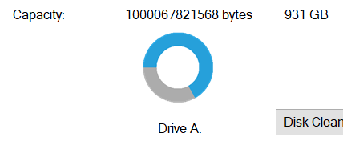
The real world IS CONFUSING!!!!
931GB
931GiB
Sometimes this is used to mean 931GiB ☹
This always means 931GiB! ☺

Slide 30
Why binary? Whynary?
Why indeed?
What color is this?
0 | 1 | 2 | 3 | 4 | 5 | 6 | 7 | 8 | 9

Slide 31
Why binary? Whynary?
Why indeed?
What color is this?
0 | 1

Slide 32
Everything in a computer is a number
Java strings are encoded using UTF-16
Most letters and numbers in the English alphabet are < 128.
“Strings are numbers”
83 116 114 105 110 103 115 32 97 114 101 32 110 117 109 98 101 114 115 0
Do try this at home: what does this mean?
71 111 111 100 32 74 111 98 0

Slide 33

EVERYTHING
Images and colors? Numbers!
Videos? Numbers!
122
185
32
239
97
181
181
40
41

